Slide 1


Session 2 DONE! Session 3: The Re-sesssion

Slide 2
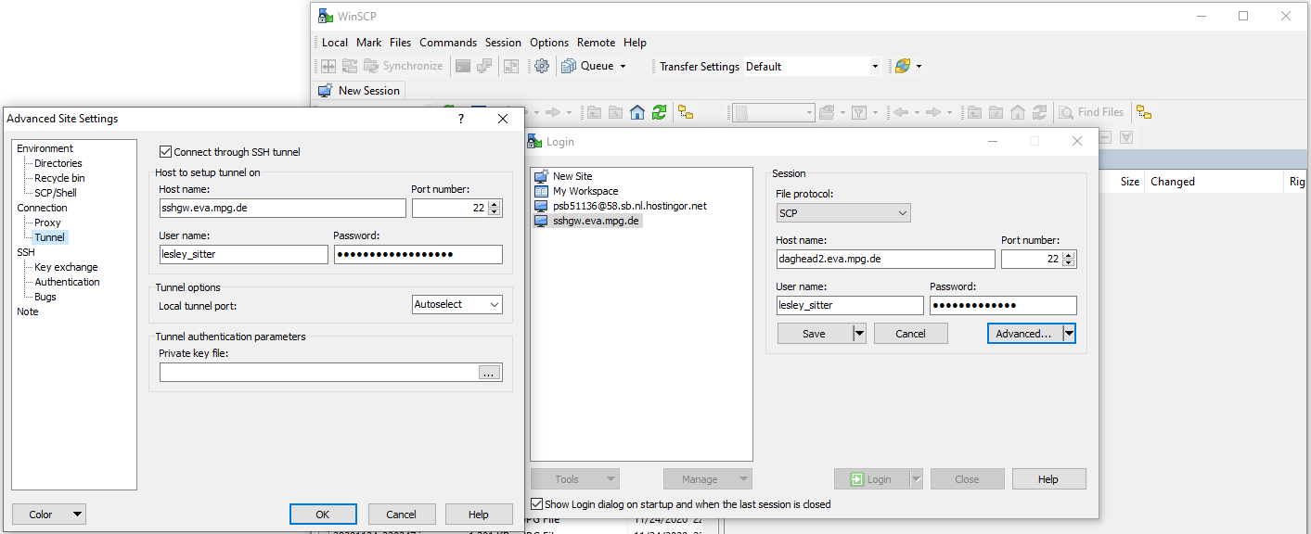
For direct connection to the server
ssh daghead2.eva.mpg.de
If this doesn’t work ssh sshgw.eva.mpg.de (username is your username, password is the password you use for mail etc) then
ssh daghead2.eva.mpg.de (username is your username, password is also your username unless you changed it)

Slide 3


Putty/Shh
Into server
Qsub
Submitting to cluster
User
Server terminal / session
on “head” node
Cluster

Slide 4
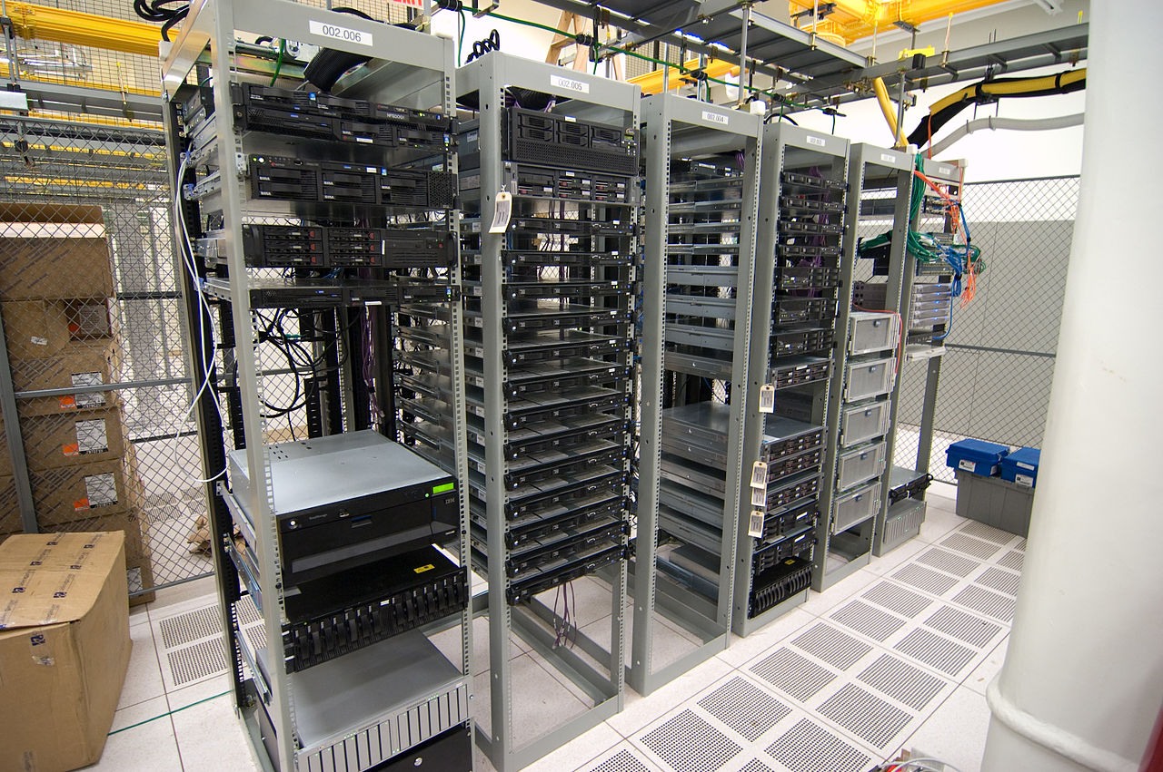
A server is just a bunch of computers without a screen.
We call the “server” or “session” or sometimes “terminal” just our connection to the first computer. From here we tell that first computer what to do, and if it needs to do it on the rest of the computers (which we call cluster… it’s a cluster of computers, sometimes called nodes)

Slide 5
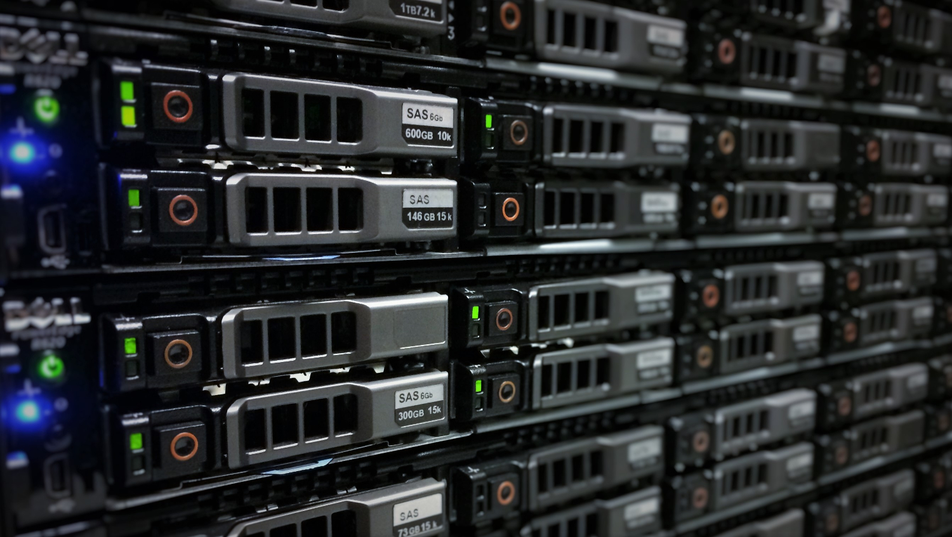
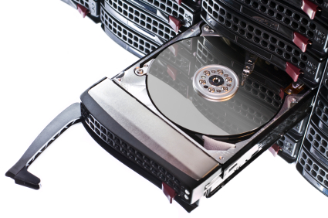
Besides the “nodes” which are computers that perform data tasks, there are also large ammounts of harddrives, not always looking like this.
These are often called “mounts”.
You can see a mount as a usb cable plugged into your PC, which then starts and connects the harddrive. Mounting is essentially that process of starting and connecting.
We use two main “mounts”, the /mnt/archgen/ for results, and the /mnt/scratch/ for playing around and testing stuff.

Slide 6
bionc14 16CPU 503Gb
bionode01-06
64CPU 755Gb
bionc04 48CPU 503Gb
/mnt/archgen/
Permanent storage
bionc11 48CPU 1Tb
bionc13 48CPU 2Tb
bionode07-08
112CPU 2Tb
bionode27 128CPU 1Tb
bionode01-34
24CPU 47Gb
bionode35-67
32/36CPU
125-376Gb
/mnt/scratch/
Temporary hdd space meant for I/O heavy jobs
bio01-97
8CPU 15Gb
Not usable
all.q
all.q, archgen.q
Our cluster is broken up like this, the two mounts, and the hundred or so “nodes”
Each of these nodes has different setup, some are very slow and underpowered for small processes,
these also include the desktop computers. Yes, the desktop computer are part of the “cluster”, if you aren’t
using a desktop PC, the system will see this and will be able to let other people run processes on it, very
efficient. This is sometimes also called a computer farm
When using “qsub” to request resources, you can specify what types of machines you want so that it will only run
on machines that can handle the job you want to perform.

Slide 7

Your one and only friend
https://kbase.eva.mpg.de/xwiki/bin/view/Departments/Archaeogenetics/
Also recommend evernote to keep a brain-farts and code snippets in the
Cloud: https://www.evernote.com
Honourable mentions:
https://www.biostars.org/ http://seqanswers.com/ (old)

Slide 8
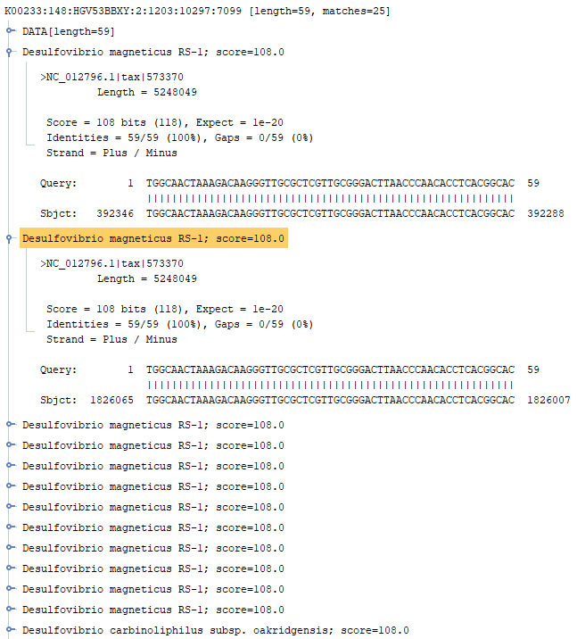
What is MALT?
Malt is a tool that does BlastN matching of your reads
To a reference database you supplied, for example a
Microbial databse
MALT stores all the BlastN alignments and can then
Perform something that make it powerfull, the LCA
Algorithm L - Lowest C - Common A – Ancestor This algorithm makes it so that MALT can look at this
list of BlastN output, and if there are hits of equal quality to multiple species, it will say that it cannot pick a species and instead will put the read in the genus list. If multiple
genera have hits of equal score, it will put it on family, etc.

Slide 9
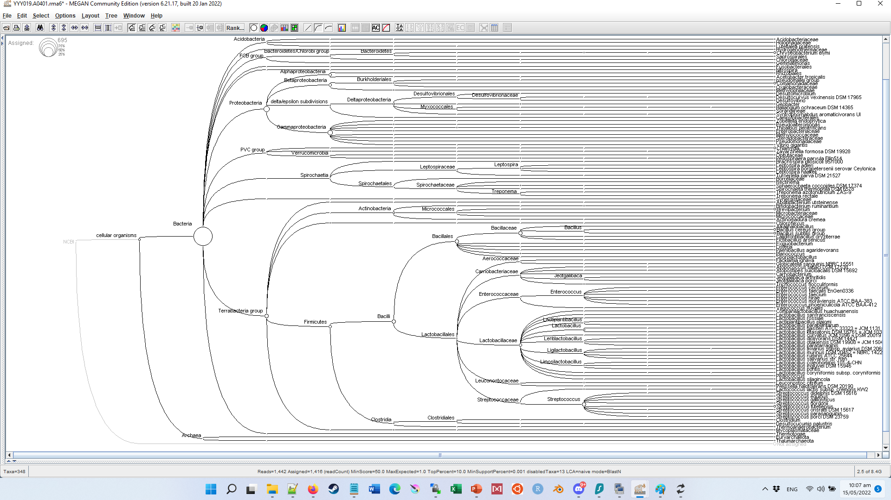

Slide 10
What is MALT?
This sorting of reads in hierarchies makes it very powerful as you can “filter” reads that are common among closely related organisms, and only look at unique reads instead of manually having to make these determinations. This allows for fast sorting of reads on a taxonomic level. The downside is that this all cost A LOT OF MEMORY, so we cannot do it on our home computers, and instead have to request the heaviest “nodes” in the cluster most of the time = bottleneck.
bionc14 16CPU 503Gb
bionode01-06
64CPU 755Gb
bionc04 48CPU 503Gb
/mnt/archgen/
Permanent storage
bionc11 48CPU 1Tb
bionc13 48CPU 2Tb
bionode07-08
112CPU 2Tb
bionode27 128CPU 1Tb
bionode01-34
24CPU 47Gb
bionode35-67
32/36CPU
125-376Gb
/mnt/scratch/
Temporary hdd space meant for I/O heavy jobs
bio01-97
8CPU 15Gb
Not usable
all.q
all.q, archgen.q

Slide 11
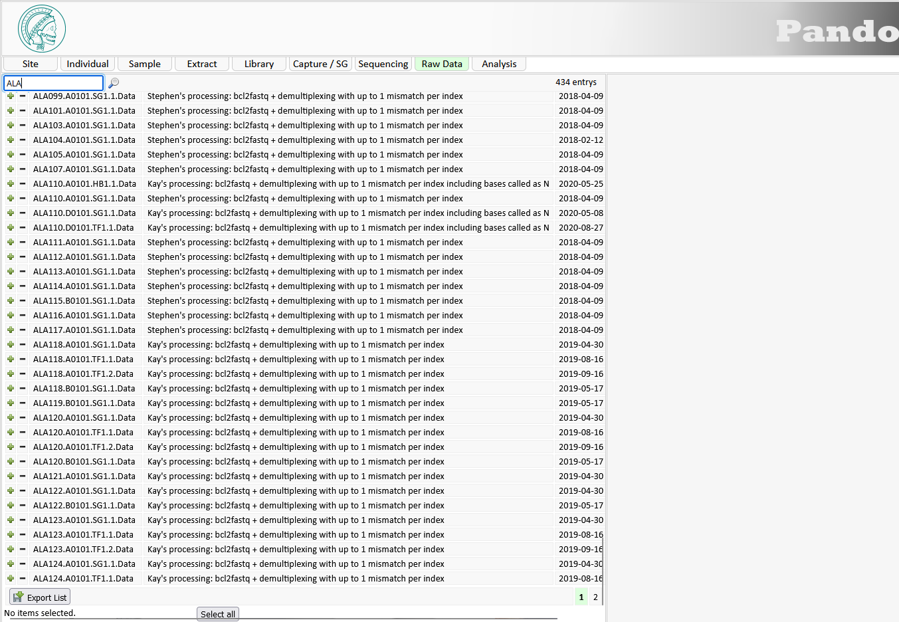
Enough talk! To do list
Get list of your samples from Pandora
Export that list
Extract the name and FASTQ data
I made you a folder on /mnt/scratch, which is the “mount” (i.e. the connected storage) of “scratch” (called scratch cause it’s meant for heavy usage, including testing stuff out or test running stuff) The folder is /mnt/scratch/tessa_zeibig
If you feel comfortable, you can make a folder, copy the fastq files into that using cp /mnt/archgen/project1/… … … /your_file.fastq.gz . Here cp is a tool (short for copy), you can see what it does by running cp --help And what we are giving cp as input is a directory to our file, and a single dot. The directory tells it where the file is located that it should perform the copy on, and the dot represents HERE So in human language this line says “copy file/location/file.fastq.gz HERE”

Slide 12
